Slide 1
RESUME PARSER WITH NLP
PROJECT GUIDE: Ms. K.GAYATHRI
BY
ARULRAJ S (18MX203)
BALA RAJENDRA KUMAR R A (19MX151)

Slide 2
AGENDA
OBJECTIVE
COMMENTS FROM REVIEW 1
HOW EXISTING SYSTEM WORKS?
NEW FEATURES OF PROPOSED SYSTEM
SYSTEM FLOW
ER DIAGRAM
USE CASE DIAGRAM
USER INTERFACE DESIGN

Slide 3
OBJECTIVE
To design a model that can parse information from unstructured resumes and transform it to a structured JSON format.
Extract resume information based on the constraints given in the job description.

Slide 4
COMMENTS FROM REVIEW 1
Check the features of existing system?
What are the new features added in the proposed system?
Any other algorithm for extracting information other than NER?

Slide 5
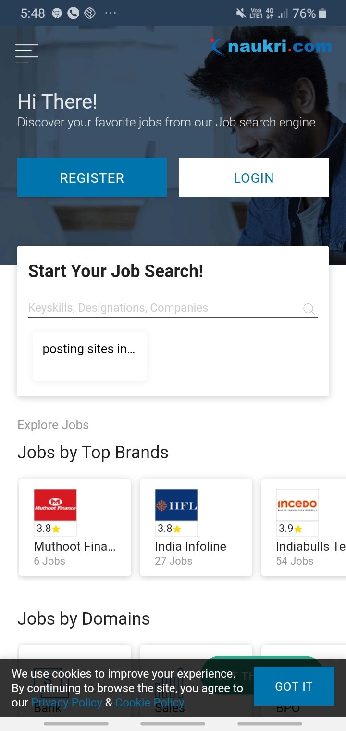
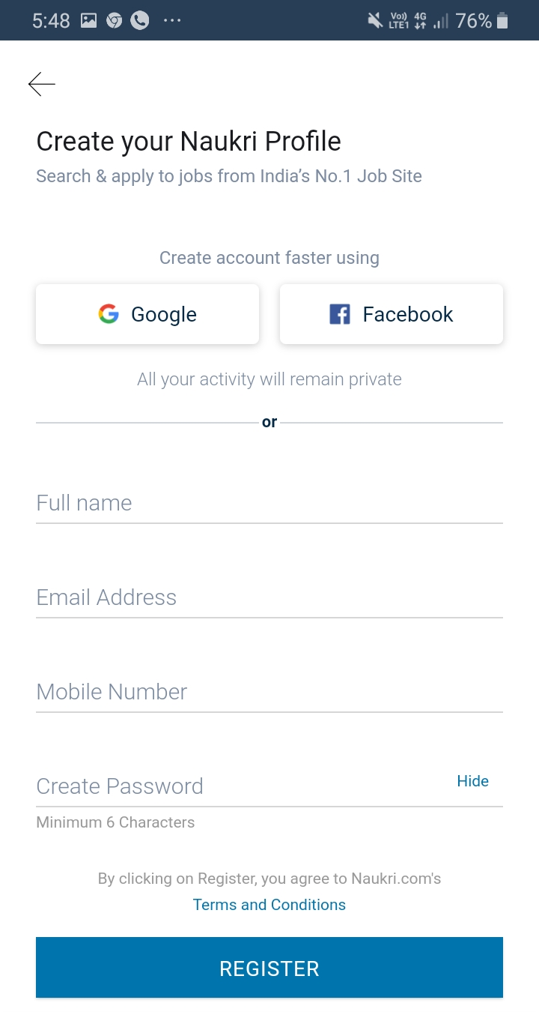
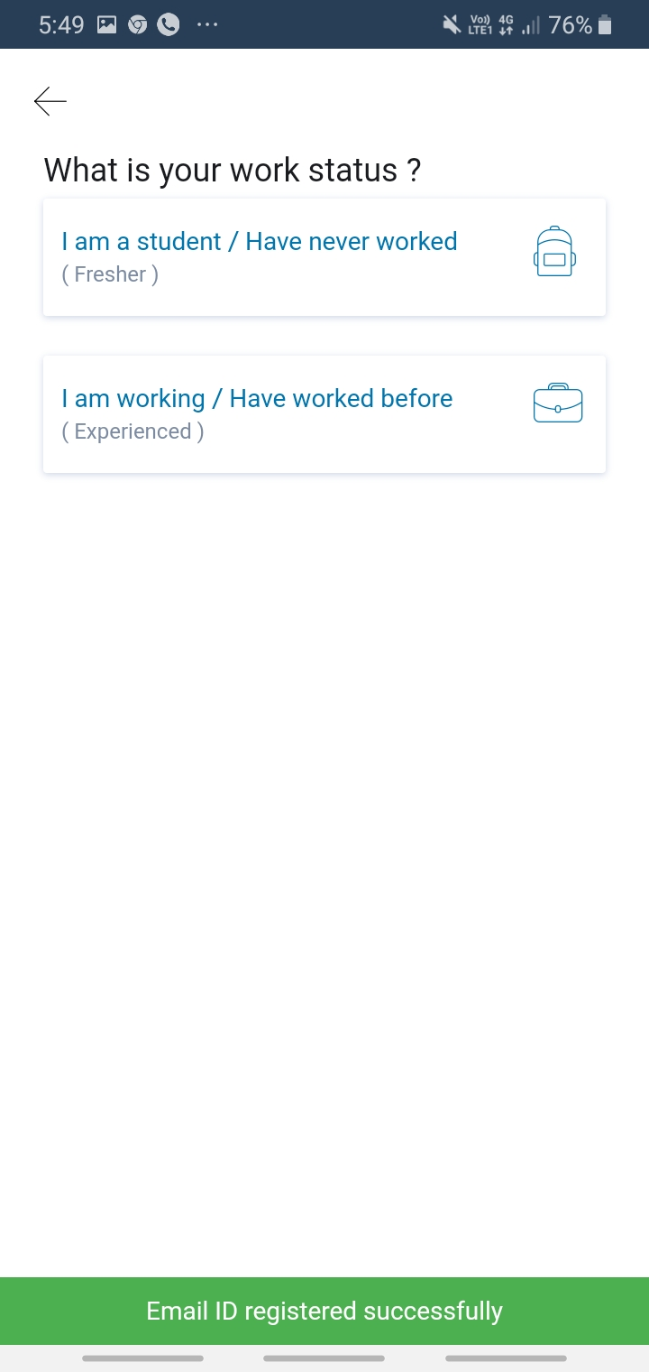

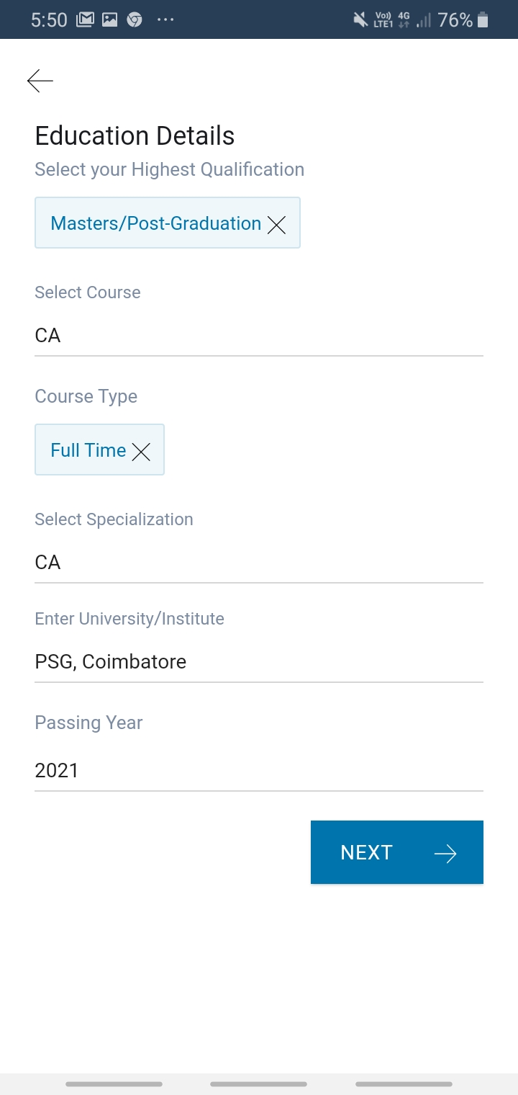
HOW EXISTING SYSTEM WORKS?

Slide 6
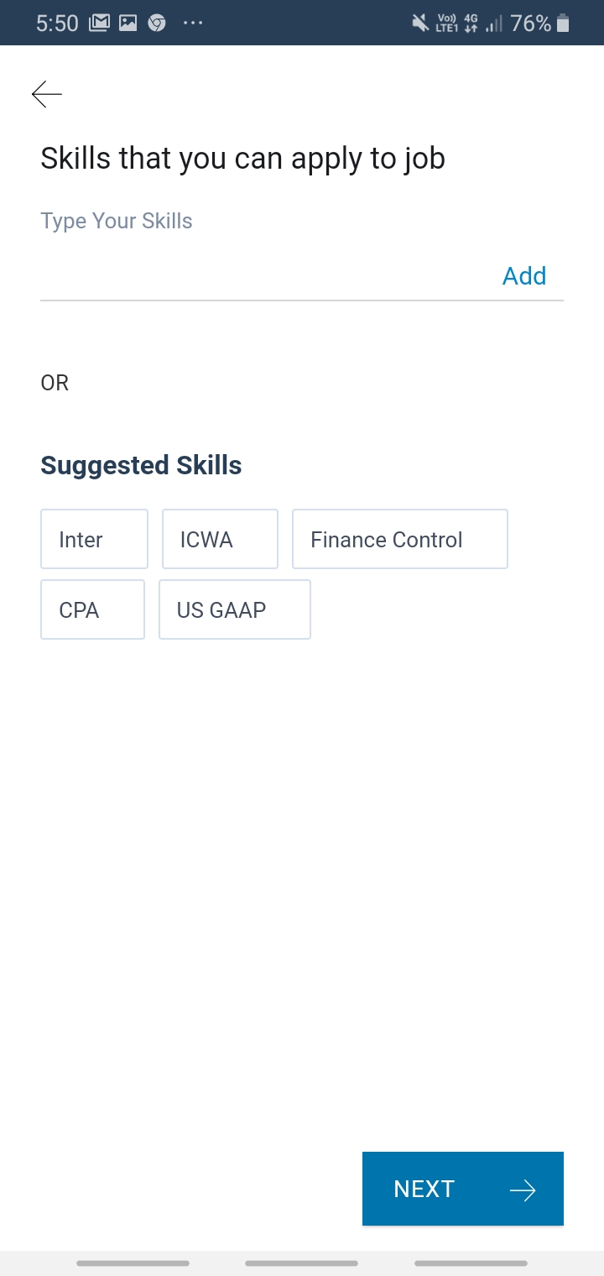
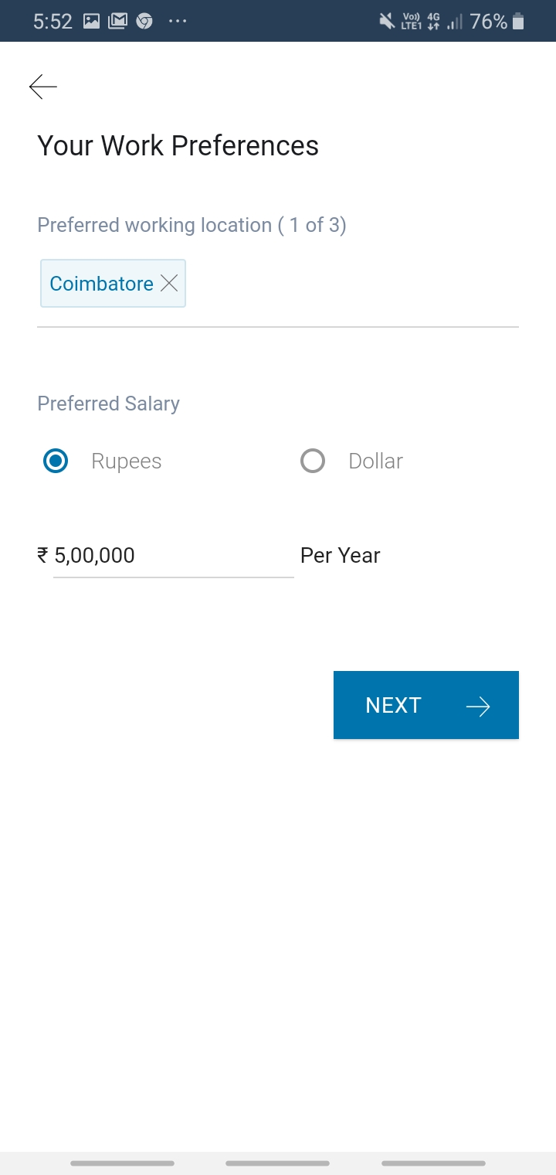
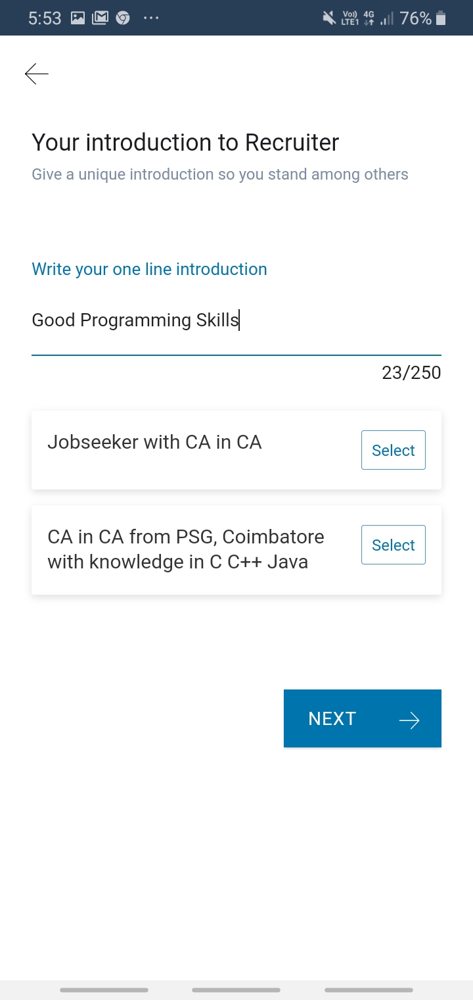
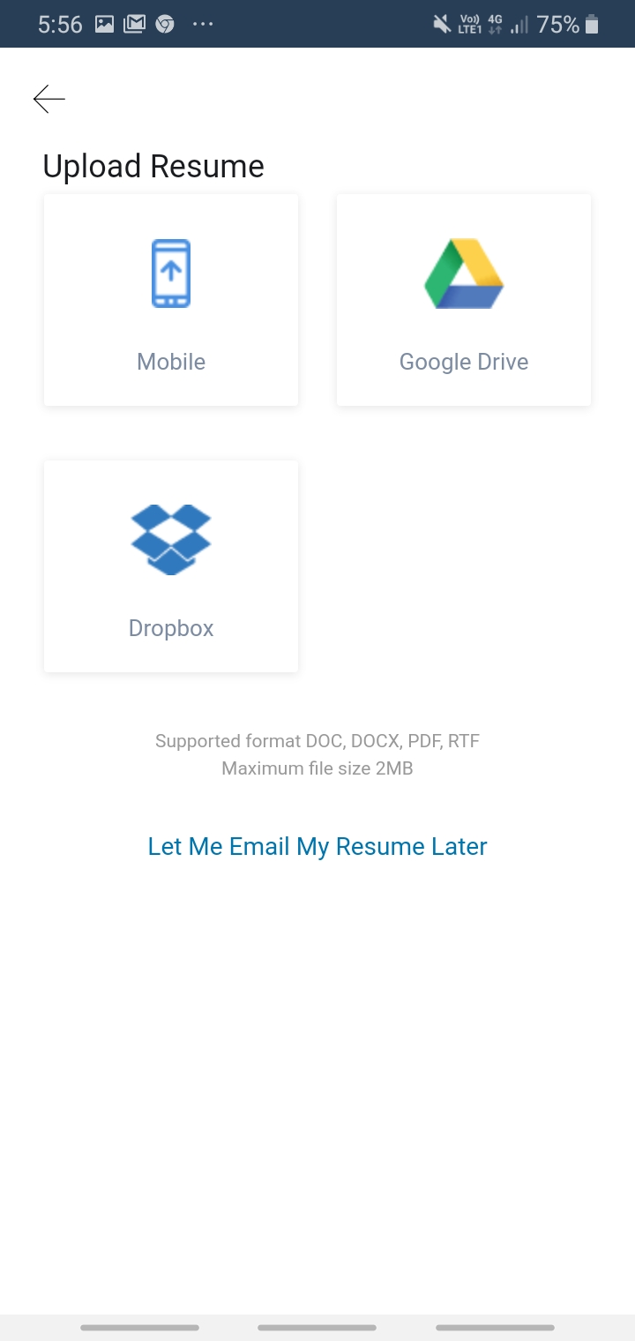
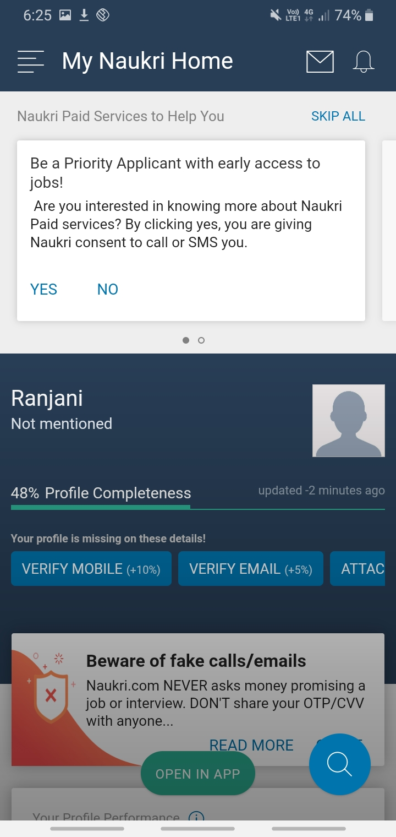
HOW EXISTING SYSTEM WORKS?

Slide 7
DRAWBACKS OF EXISTING SYSTEM
Job portals are interface between recruiter and job seeker
Needs high storage repository to store all resumes
Existing job portals may not secured
Frequent job offers will be only visible for paid candidates
Each candidate must pay the amount for frequent job offers
Resumes must be in a predefined format
Each resume must have a header information consist of 256 characters

Slide 8
NEW FEATURES Added in the PROPOSED SYSTEM
Only the registered recruiters can view the list of eligible candidates. So secured
Resume parser is free of cost
No need to store the resumes of all candidates into the database
Resume parser will store only the extracted information from resumes into the database
Resume data is extracted and stored in JSON format
No predefined format and structure of resume
Accuracy of information extracted is to be analysed

Slide 9
ALGORITHM FOR ENTITY EXTRACTION
Named-entity recognition (NER) (also known as entity extraction)
It is a sub-task of information extraction
Locate and classify named entities in text into pre-defined categories
Predefined Categories are
names of persons
organizations
locations

Slide 10
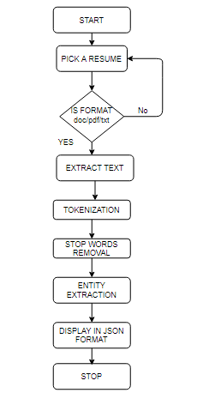
SYSTEM FLOW

Slide 11
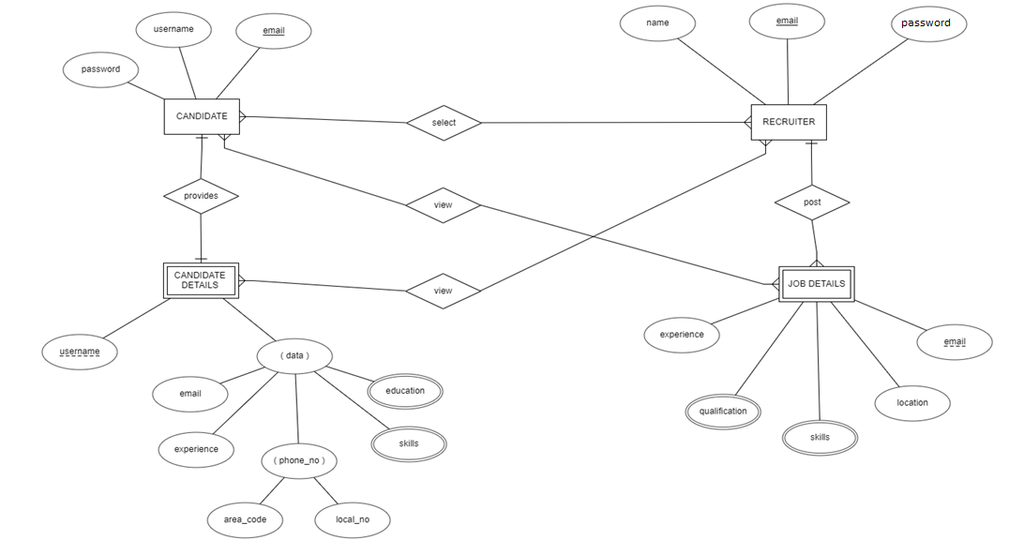
ENTITY RELATIONSHIP DIAGRAM

Slide 12
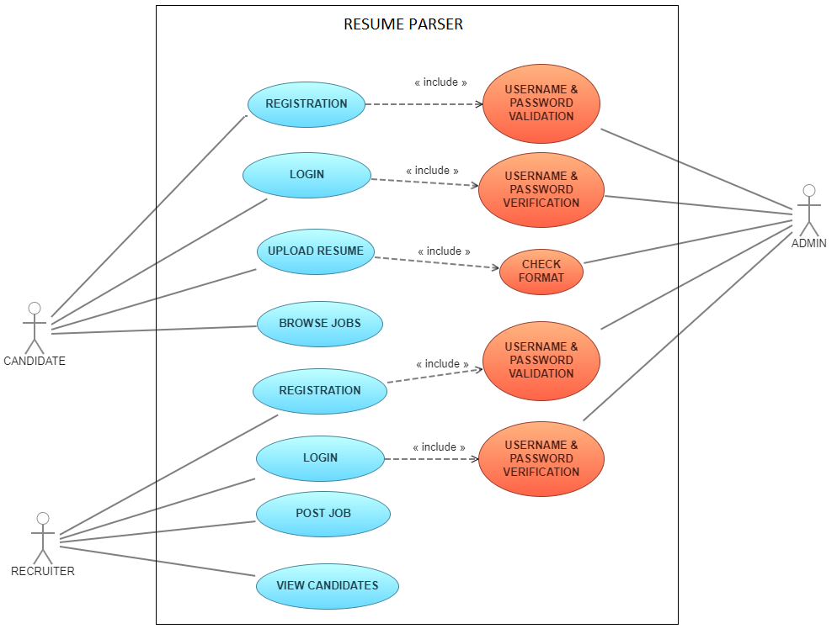
USE CASE DIAGRAM

Slide 13
WORKDONE TILL NOW
FILE UPLOAD
READING .pdf,.docx,.txt RESUMES
CONVERTING INTO TEXT FORMAT
TOKENIZATION
STOPWORDS REMOVAL
ENTITY EXTRACTION
CONVERT ENTITY INTO JSON

Slide 14
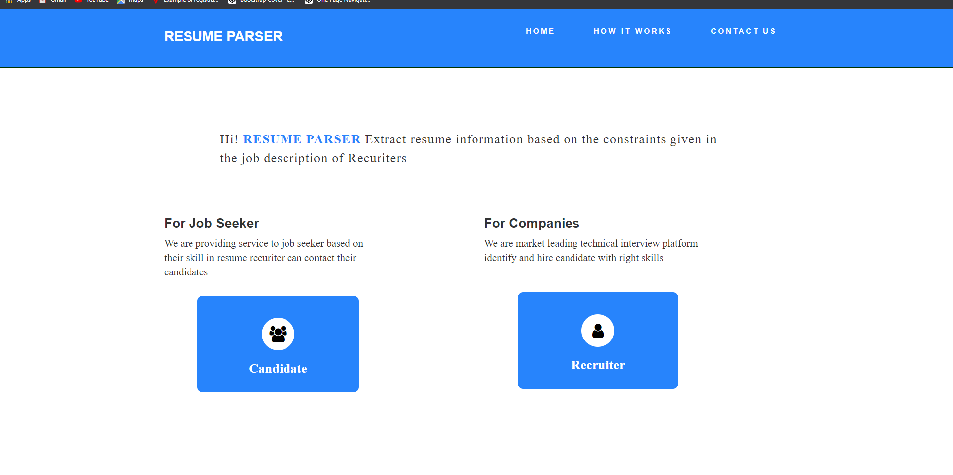
USER INTERFACE DESIGN

Slide 15
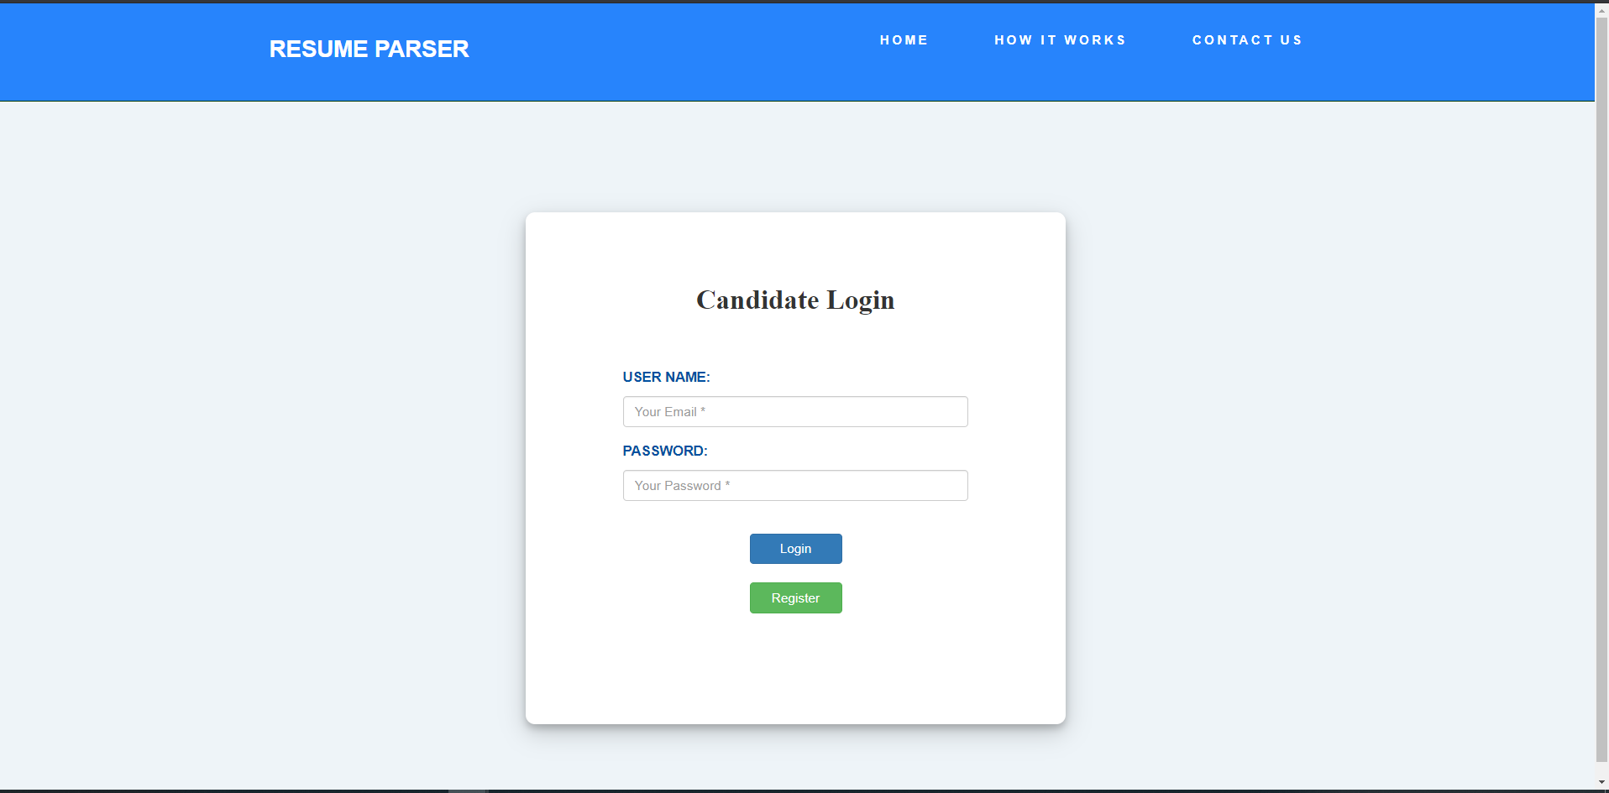

Slide 16
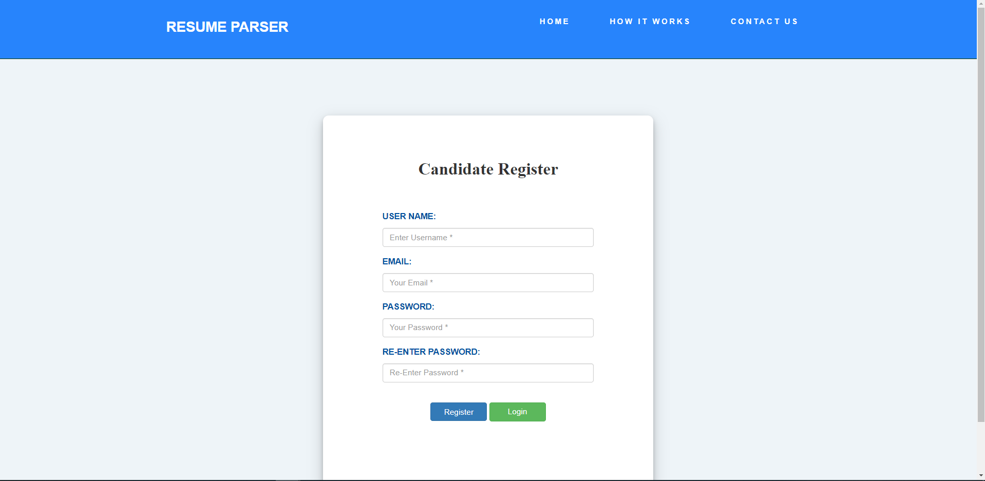

Slide 17
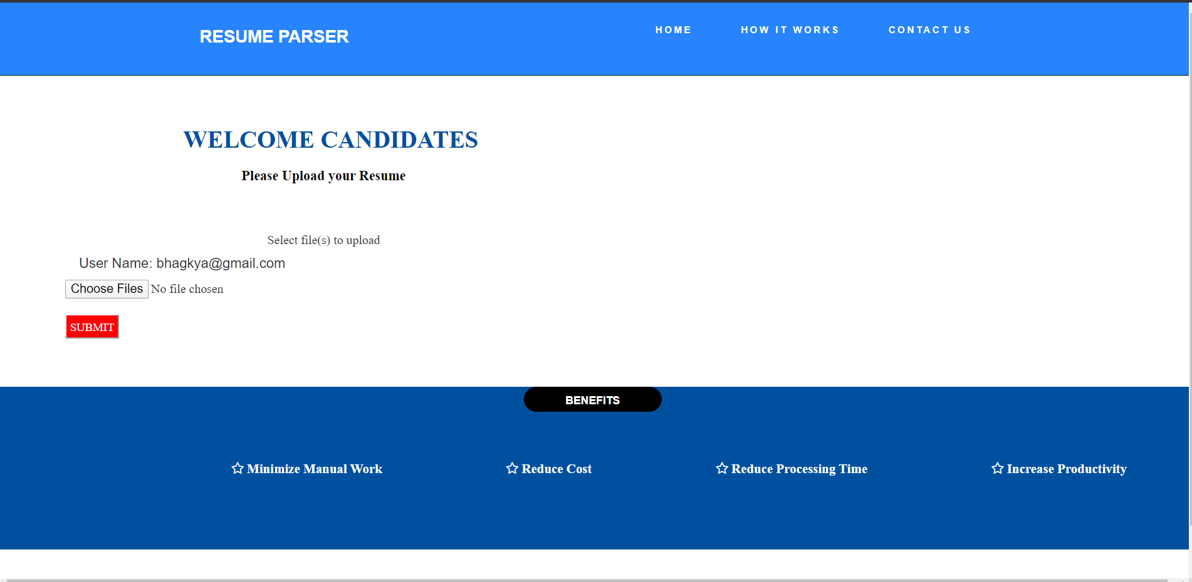

Slide 18
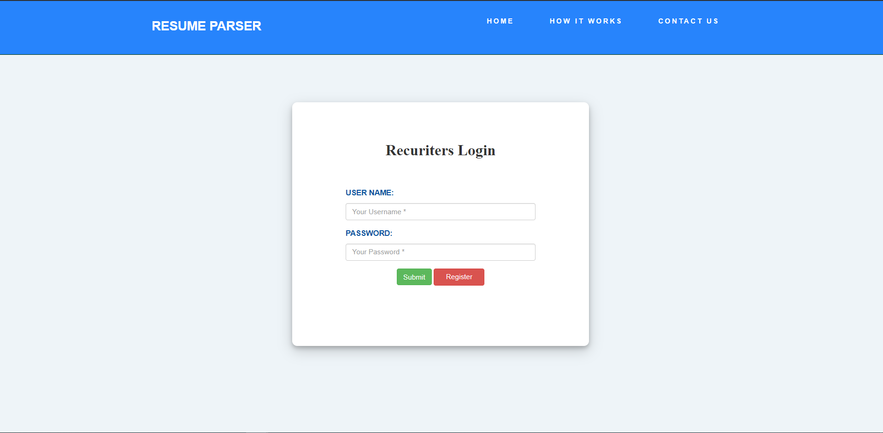

Slide 19
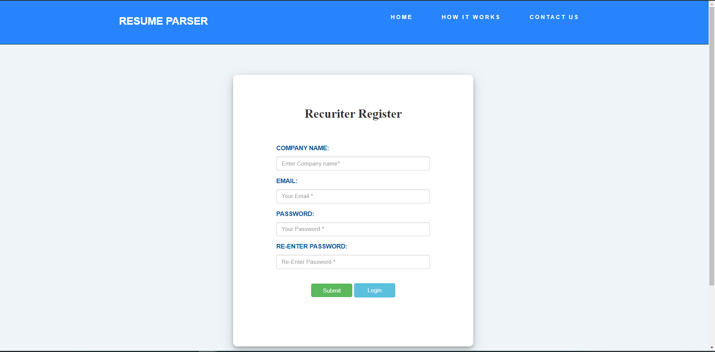

Slide 20
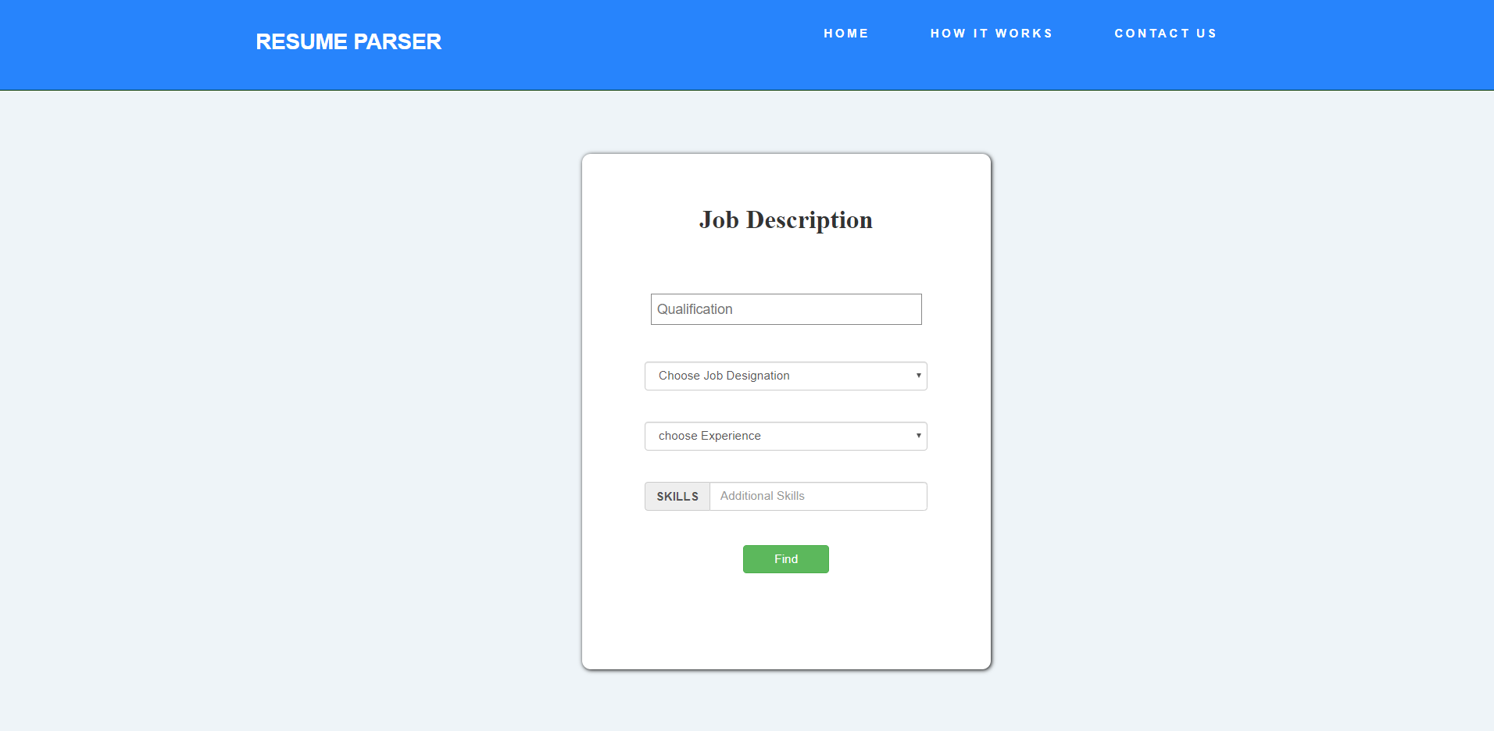

Slide 21
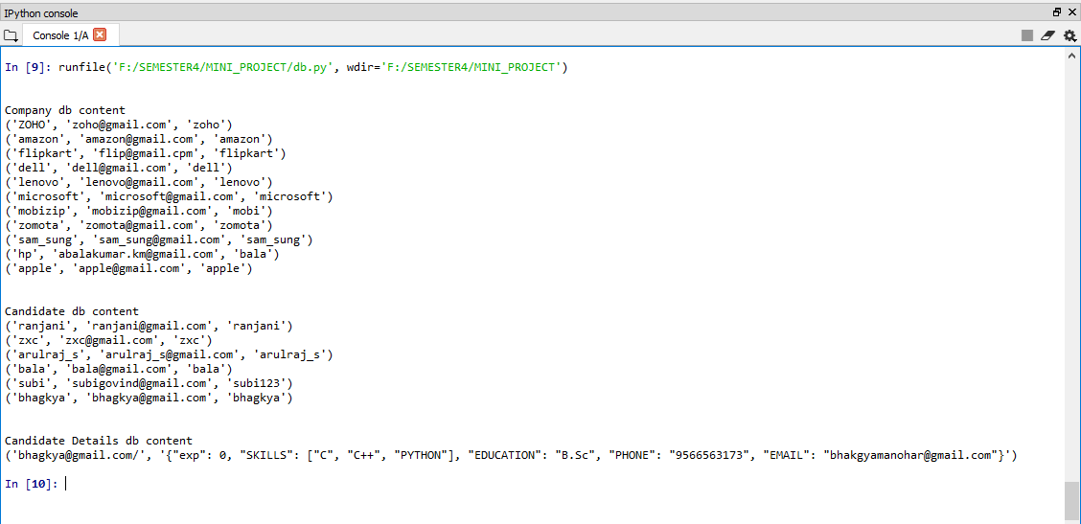
OUTPUT

Slide 22
WORK TO BE DONE:
RECRUITER POSTING JOB DESCRIPTION
RECRUITER VIEWING THE ELIGIBLE CANDIDATES
CANDIDATES VIEWING THE JOBS
ALL JOBS
JOBS BY COMPANY
JOBS BY LOCATION
ACCURACY OF INFORMATION EXTRACTED TO BE ANALYSED

Slide 23
THANKYOU

